Slide 1

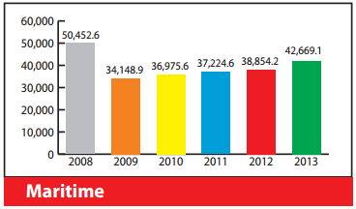
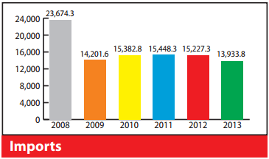

Author
^{Affiliation}
Author
^{Affiliation}
TITLE
Introduction
Discussion
Guide: Brief context and motivation for the research or presentation. Highlight the problem statement and objectives.
Guide: Interpret the findings and relate them to the broader context. Highlight the significance and potential impact of the work.
Methods/Approach
Guide: Summarise the methodology or approach used in your research, project, or initiative. Include visuals like flowcharts, diagrams, or images to make it engaging.
Conclusion
Guide: Summarise the main outcomes or recommendations. Briefly outline future directions or implications.
Results
Guide: Present the key findings using charts, graphs, or bullet points. Make sure the visuals are clear and labelled.
Acknowledgements
Guide: Thank funding agencies, collaborators, or institutions. Use logos for sponsors or affiliations where applicable.
References
Guide: Include the most relevant references cited in the work.

